Slide 1

AI-Driven - Smart Vehicle Breakdown Assistance and Autonomous Service Coordination System
SOA Project Review-1
 | Under the Guidance of Dr. NEELIMA GOGINENI Associate Professor, Department of Computer Science and Engineering, KLH CSE Bowrampet Campus
Team Members R. Dhanusha (2420030159) M. Lekha Sri (2420030334)

Slide 2
Outline of Project Work
Focus
Introduction
Literature Survey
Challenges
Research Objectives
Conclusion & Future Work
References
Publications Details

Slide 3

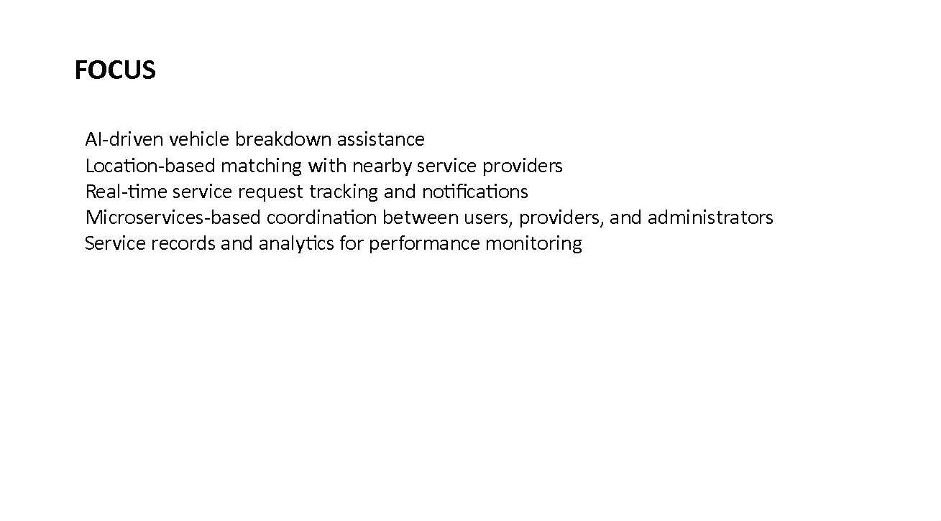


Slide 4
Problem Statement
Unpredictable breakdowns: Engine failure, battery issues, flat tires, overheating, or fuel problems can strand drivers with no warning — especially on long journeys or in unfamiliar areas.
Slow, manual assistance: Traditional roadside help depends on manually searching for a nearby mechanic or waiting for a service call, which wastes critical time during emergencies.
No centralized platform: There is no single system that lets a driver report a breakdown, share their exact location, and get matched automatically with the right kind of nearby help.
Poor coordination: Vehicle owners, service providers, and administrators currently have no shared, real-time view of a request's status — leading to delays and miscommunication.

Slide 5
Objectives
Centralized reporting: Provide a single platform where users can register vehicles, report breakdown details, and share live GPS location.
Smart matching: Automatically identify the type of breakdown and connect the user with suitable, nearby service providers.
Structured provider workflow: Let service providers view, accept or reject requests, navigate to the user, and update the service status.
Real-time tracking & notifications: Keep users informed at every stage — acceptance, en-route, in-progress, and completion — with live status updates.
Administrative oversight: Build an admin module to manage users, service providers, breakdown requests, and monitor overall service quality.
Records & analytics: Maintain breakdown and service history to support reporting, performance tracking, and continuous improvement.

Slide 6
Literature Survey
Authors | Title of the Paper | Methodology | Inferences | Limitation/Future work
G. Thiagarajan et al. (2025) | Vehicle Breakdown Assistance System for On-Road, IRJAEH | Mobile platform using real-time location matching (Flutter/OpenStreetMap) with AI-based service allocation and Firebase authentication | Reported around 92% allocation accuracy and faster response than earlier benchmark systems | Depends on continuous network connectivity; predictive fault detection not yet implemented
M. Dongre et al. (2020) | IoT-Based On-Road Vehicle Breakdown Assistance, IJSRCSEIT | GPS and GSM modules paired with a mobile app to dispatch the nearest mechanic and send emergency alerts | Reduced emergency response time to about 3 minutes and improved mechanic-location efficiency by roughly 40% | Hardware-dependent (dedicated GPS/GSM modules), limiting scalability as a pure software service
V. Pavan Kalyan et al. (2025) | RESQDRIVE: Real-Time Vehicle Breakdown Assistance Web App, SSRN | Location-aware web application connecting drivers and mechanics via role-based dashboards | Showed lightweight web platforms can deliver scalable, real-time roadside coordination | Web-only reach; lacks a dedicated admin analytics/monitoring layer across requests

Slide 7
Problem Gap Identification
Fragmented workflows: Existing apps mostly cover mechanic discovery or GPS tracking alone, with no end-to-end flow from breakdown report to service completion.
Single-platform lock-in: Most solutions are mobile-only or web-only monoliths rather than a service-oriented architecture where modules can scale and evolve independently.
Weak administrative visibility: Very few systems give administrators a unified view to monitor users, providers, requests, and service quality in one place.
No automated issue classification: Reported problems (engine, battery, tyre, fuel, overheating) are rarely auto-classified, so requests aren't routed to the right specialist provider.
Limited data-driven insight: Existing systems seldom capture structured records for analytics such as response time, completion rate, or provider performance.

Slide 8
Innovation, Creativity, and Novelty
Service-oriented design: Registration, request handling, matching, notifications, tracking, and admin analytics are built as independent, loosely-coupled microservices for easy scaling and maintenance.
Breakdown-aware matching: The system automatically classifies the reported issue and routes it to the right category of nearby service provider, rather than a generic mechanic list.
Unified multi-stakeholder experience: One platform connects vehicle owners, service providers, and administrators with synchronized, real-time status updates end to end.
Built-in analytics: A dedicated reporting module tracks request volume, completion rates, and provider performance, enabling continuous, data-driven improvement of the service.
Location-first UX: GPS-based location capture and map-based nearest-provider discovery minimize the time and effort needed to get help during a stressful situation.

Slide 9
Feasibility and Project Plan
Feasibility
Technical: Microservices backend, MySQL database, GPS-based location services, and a mobile/web front end.
Operational: Simple registration and request flow, with a clear accept/reject/update workflow for providers.
Economic: Open-source frameworks and cloud hosting keep costs low for an academic-scale rollout.
Project Timeline
Phase 1
Requirement Analysis & Design
Wk 1-2
Phase 2
Database & Microservices Setup
Wk 3-4
Phase 3
Core Module Development
Wk 5-7
Phase 4
Notifications & Admin Panel
Wk 8-9
Phase 5
Testing & Deployment
Wk 10

